Slide 1
Planning & Evaluating Educational Programs
Course Learning Outcomes
K1 Critically evaluate and identify the needs for new educational programs based on structured and strategic analyses.
K2 Examine and discuss challenges that could hinder effective program planning, delivery and evaluation and possible measures to overcome the challenges.
S1 Develop frameworks for planning the design and development of new educational programs/curricula or courses.
S2 Craft strategies to enhance learning experiences in line with the goals of any newly developed educational program.
AR1 Determine how evaluation can be credibly done and used to improve program decision making.
RC1 Apply standards of quality assurance in the planning, design, development and assessment of educational programs in schools and department of educations.
SD1 Develop knowledge and skills for ensuring that educational programs are sustainable.
1. Dubai government mission
2. Knowledge base economy
3. Smart Learning

Slide 2
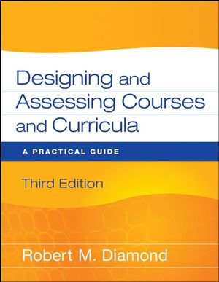
Exploring the Course Resources
Required Text Book:
Robert M. Diamond (2008). (3rd ed.). John Willey & Sons

